Slide 1

Dan Jurafsky and James Martin
Speech and Language Processing
Chapter 6:
Vector Semantics

Slide 2
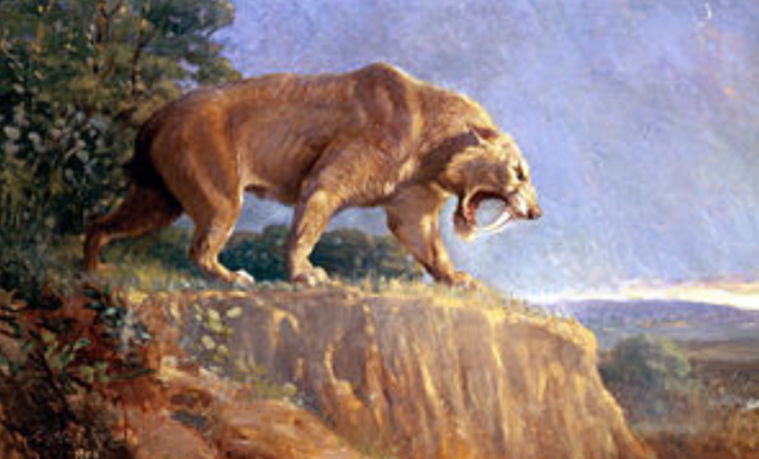
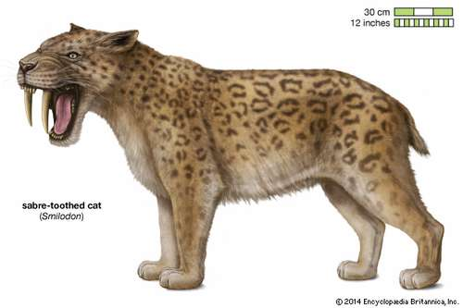
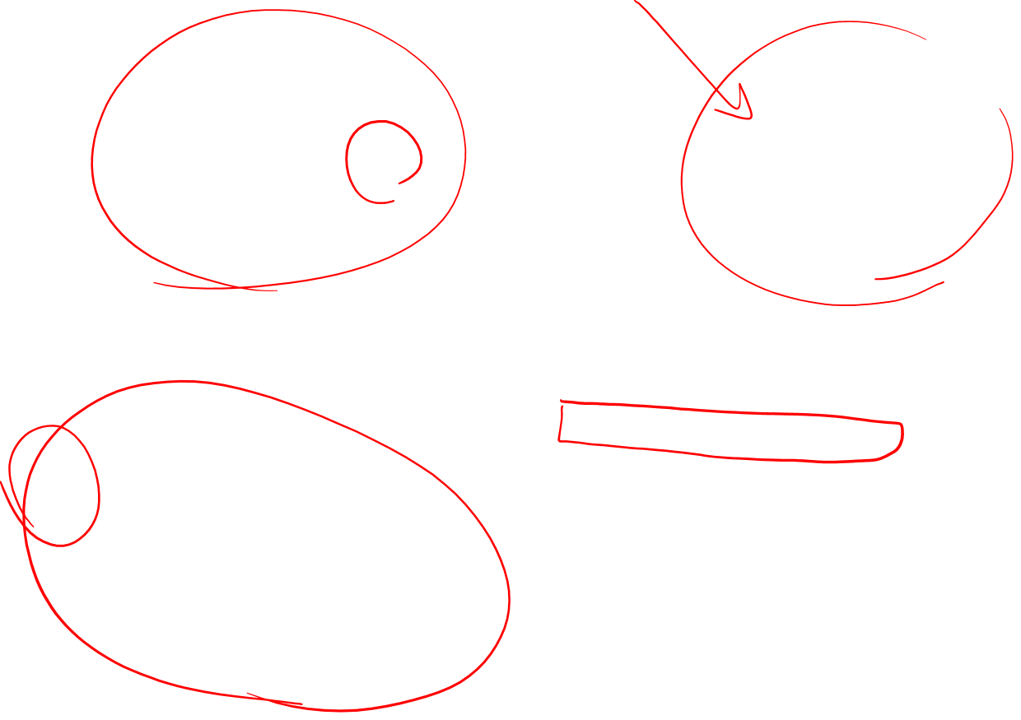
Similarity
The similarity of these two mammals is one of many examples of parallel or convergent evolution, in which particular contexts or environments lead to the evolution of very similar structures in different species (Gould, 1980).

Slide 3
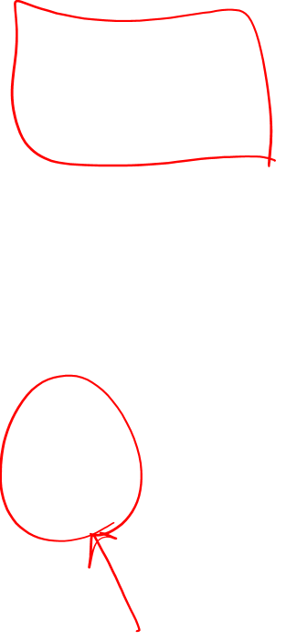
What do words mean?
First thought: look in a dictionary
http://www.oed.com/

Slide 4
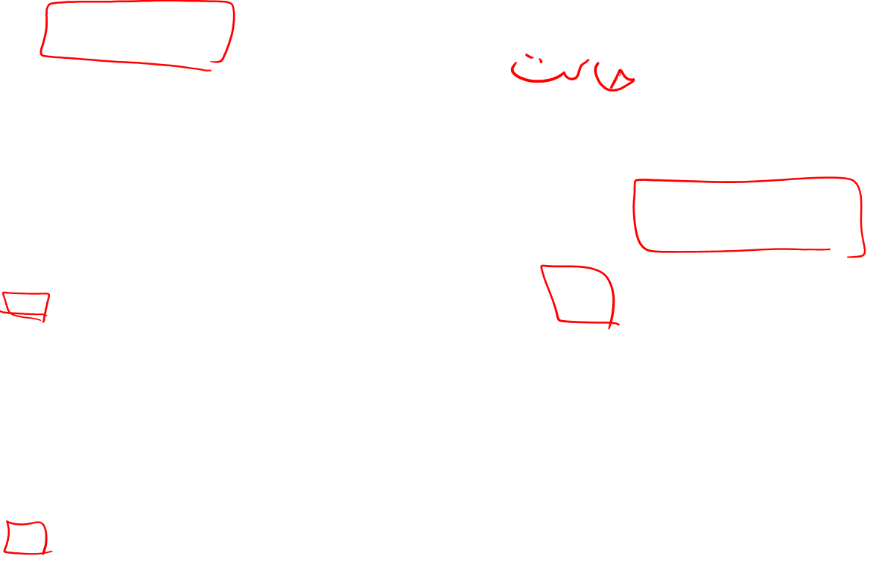
Words, Lemmas, Senses, Definitions
lemma
sense
definition

Slide 5
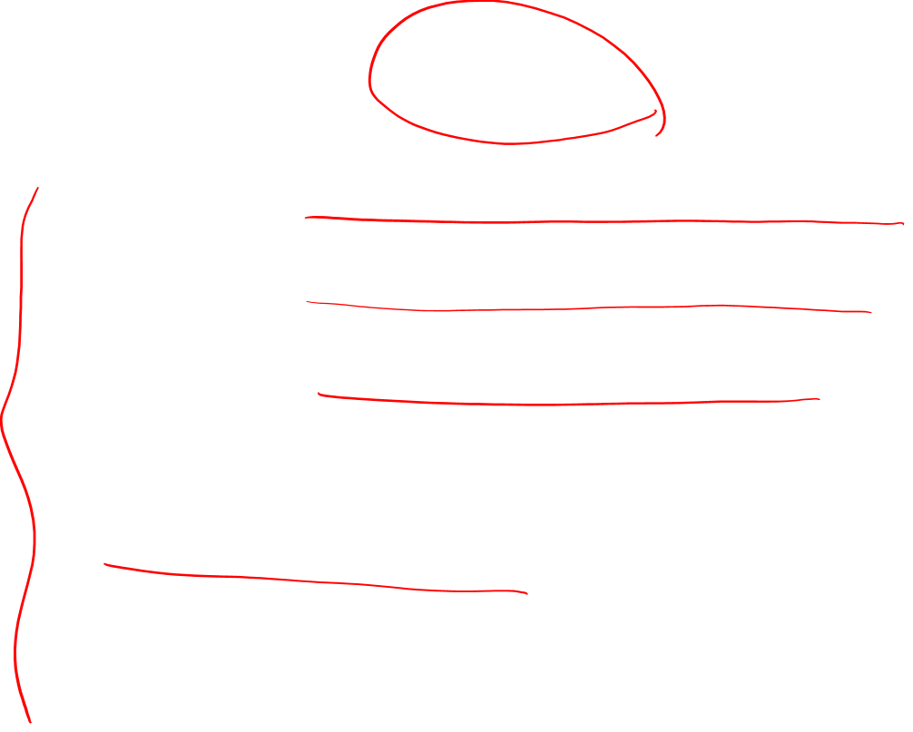
Lemma pepper
Sense 1: spice from pepper plant
Sense 2: the pepper plant itself
Sense 3: another similar plant (Jamaican pepper)
Sense 4: another plant with peppercorns (California pepper)
Sense 5: capsicum (i.e. chili, paprika, bell pepper, etc)

Slide 6
A sense or “concept” is the meaning component of a word

Slide 7
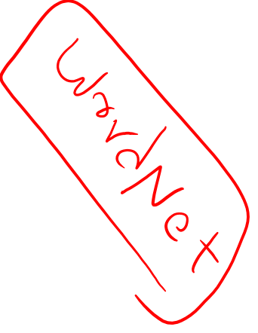
There are relations between senses

Slide 8
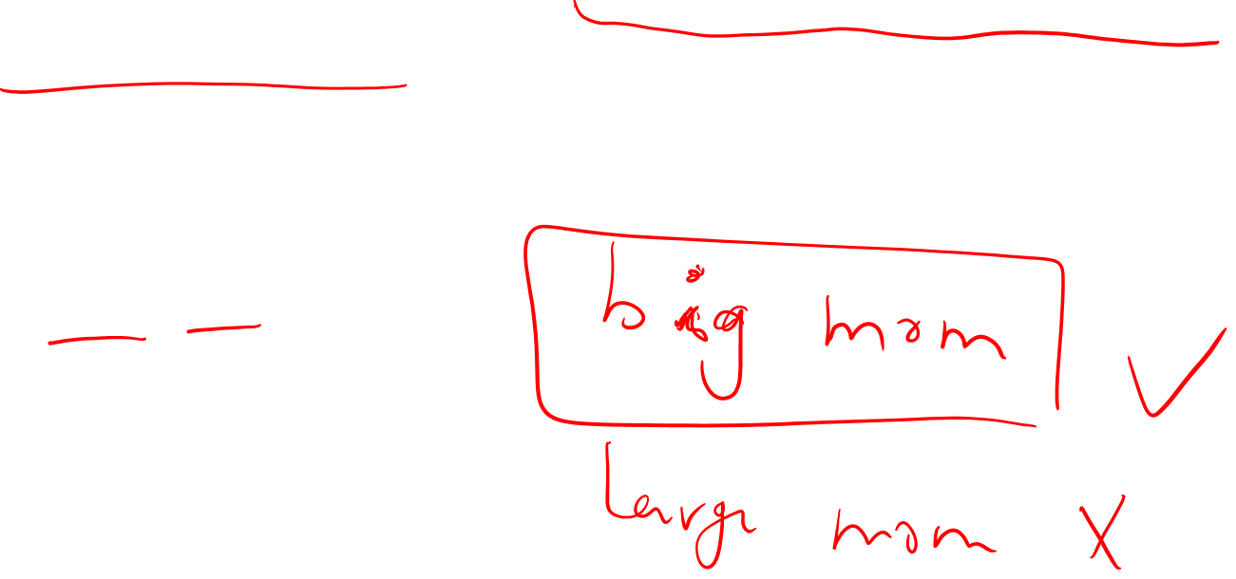
Relation: Synonymity
Synonyms have the same meaning in some or all contexts.
filbert / hazelnut
couch / sofa
big / large
automobile / car
vomit / throw up
Water / H₂0

Slide 9
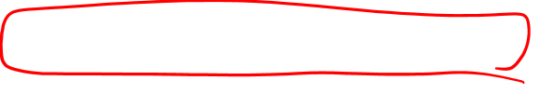
Relation: Synonymity
Note that there are probably no examples of perfect synonymy.
Even if many aspects of meaning are identical
Still may not preserve the acceptability based on notions of politeness, slang, register, genre, etc.
The Linguistic Principle of Contrast:
Difference in form -> difference in meaning

Slide 10
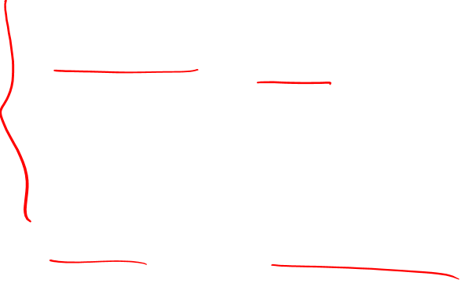
Relation: Synonymity?
Water/H₂0
Big/large
Brave/courageous

Slide 11
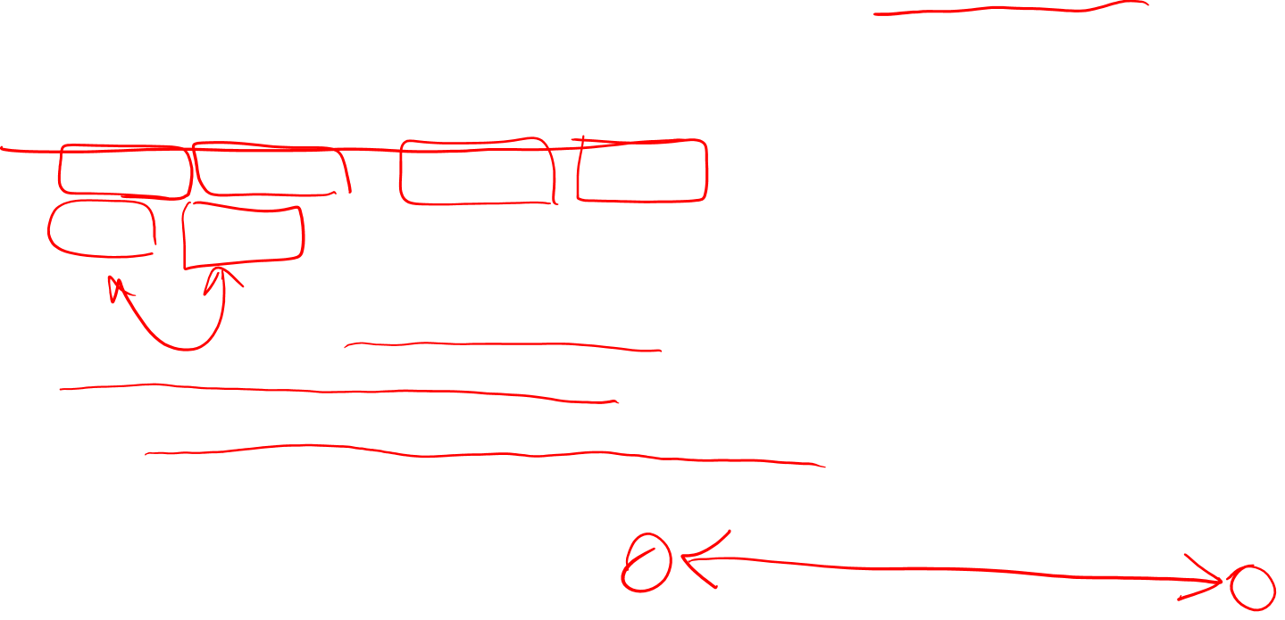
Relation: Antonymy
Senses that are opposites with respect to one feature of meaning
Otherwise, they are very similar!
dark/light short/long fast/slow rise/fall
hot/cold up/down in/out
More formally: antonyms can
define a binary opposition
or be at opposite ends of a scale
long/short, fast/slow
Be reversives:
rise/fall, up/down

Slide 12
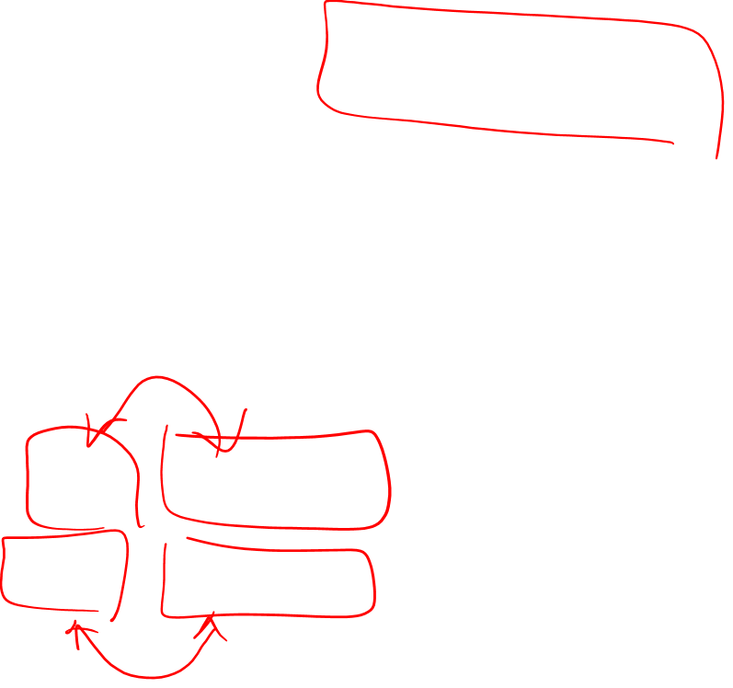
Relation: Similarity
Words with similar meanings. Not synonyms, but sharing some element of meaning
car, bicycle
cow, horse

Slide 13
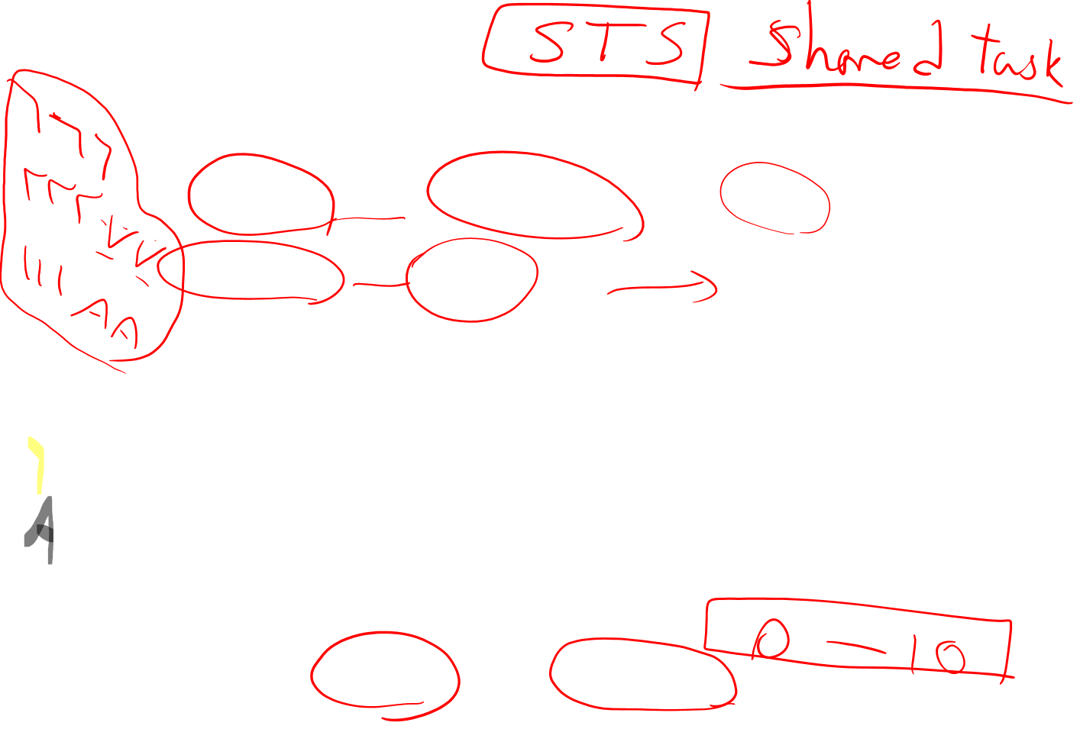
Ask humans how similar 2 words are
word1 | word2 | similarity
vanish | disappear | 9.8
behave | obey | 7.3
belief | impression | 5.95
muscle | bone | 3.65
modest | flexible | 0.98
hole | agreement | 0.3
SimLex-999 dataset (Hill et al., 2015)

Slide 14
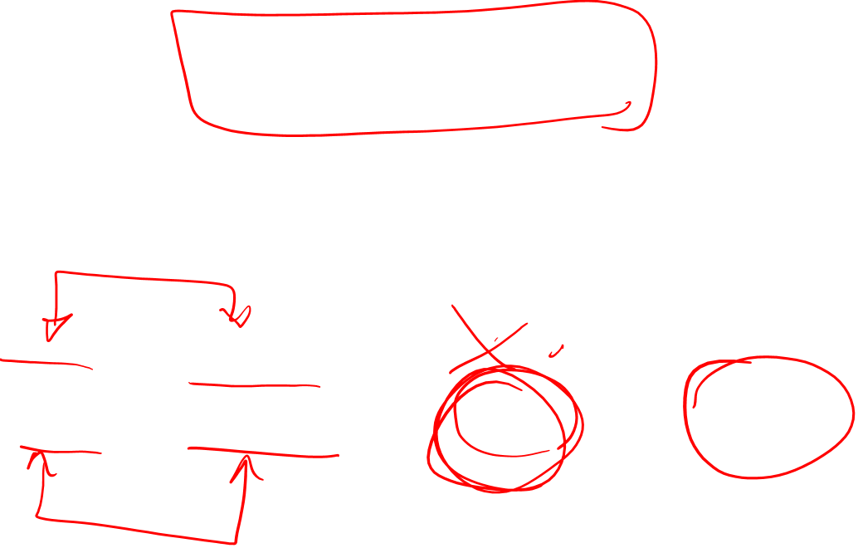
Relation: Word relatedness
Also called "word association"
Words be related in any way, perhaps via a semantic frame or field
car, bicycle: similar
car, gasoline: related, not similar

Slide 15
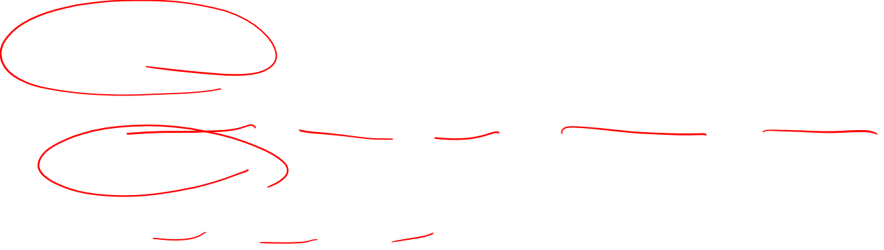
Semantic field
Words that
cover a particular semantic domain
bear structured relations with each other.
hospitals
surgeon, scalpel, nurse, anaesthetic, hospital
restaurants
waiter, menu, plate, food, menu, chef),
houses
door, roof, kitchen, family, bed

Slide 16
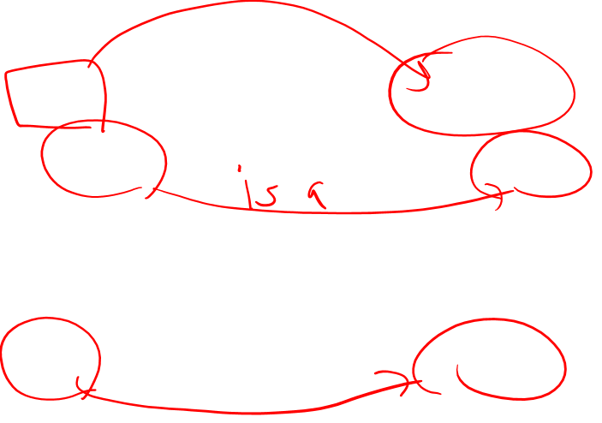
Relation: Superordinate/ subordinate
One sense is a subordinate of another if the first sense is more specific, denoting a subclass of the other
car is a subordinate of vehicle
mango is a subordinate of fruit
Conversely superordinate
vehicle is a superordinate of car
fruit is a subordinate of mango
wit
Superordinate | vehicle | fruit | furniture
Subordinate | car | mango | chair

Slide 17
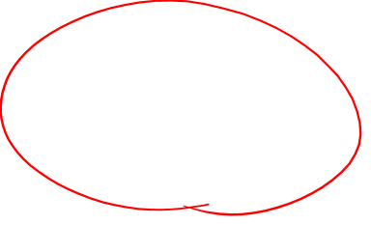
These levels are not symmetric
One level of category is distinguished from the others
The "basic level"

Slide 18
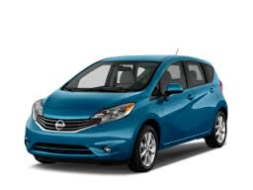
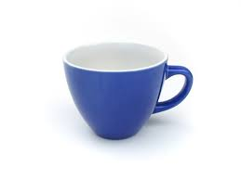
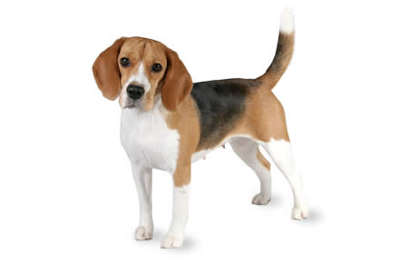

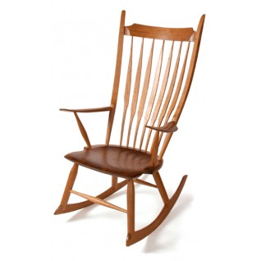
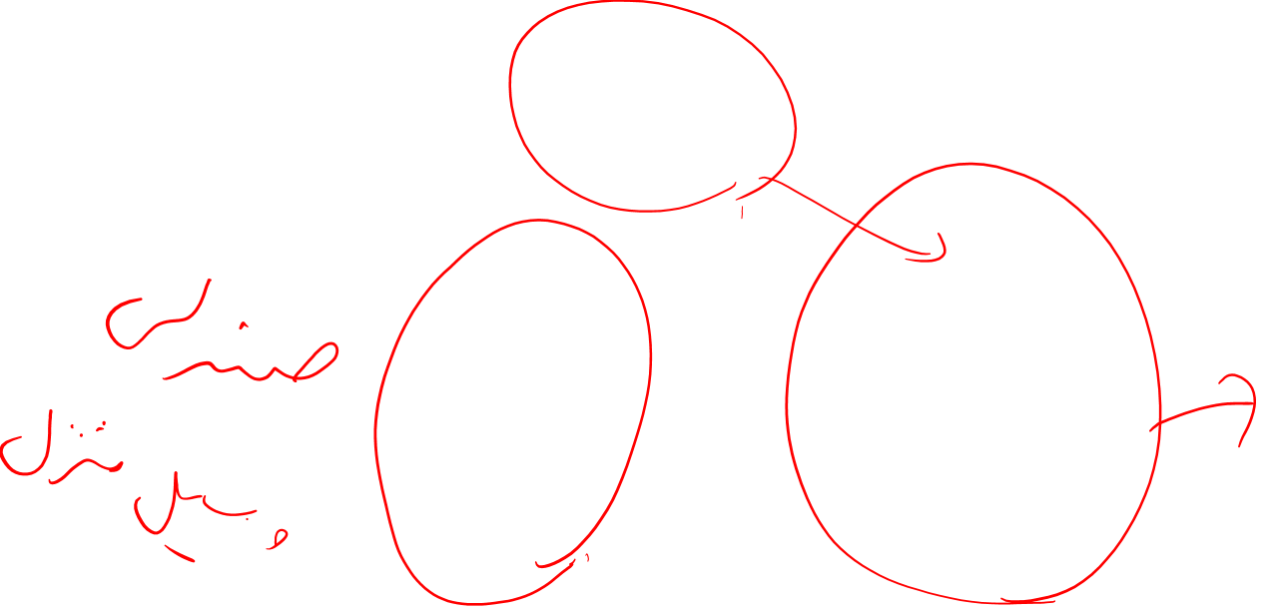
Name these items

Slide 19
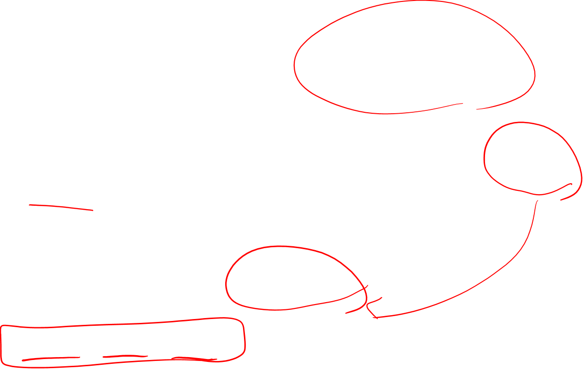
Cluster of Interactional Properties
Basic level things are “human-sized”
Consider chairs
We know how to interact with a chair (sitting)
Not so clear for superordinate categories like furniture
“Imagine a furniture without thinking of a bed/table/chair/specific basic-level category”

Slide 20
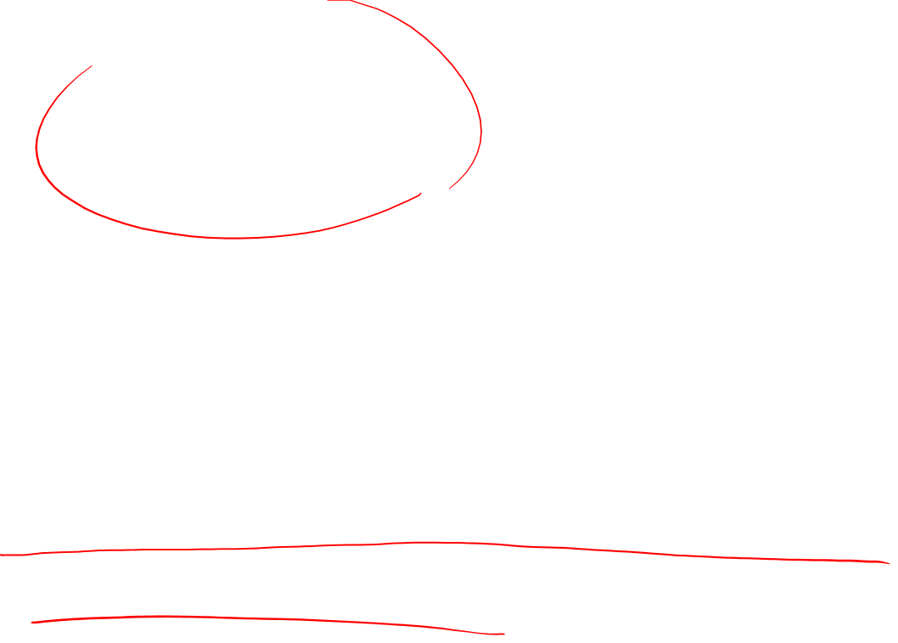
The basic level
Is the level of distinctive actions
Is the level which is learned earliest and at which things are first named
It is the level at which names are shortest and used most frequently

Slide 21
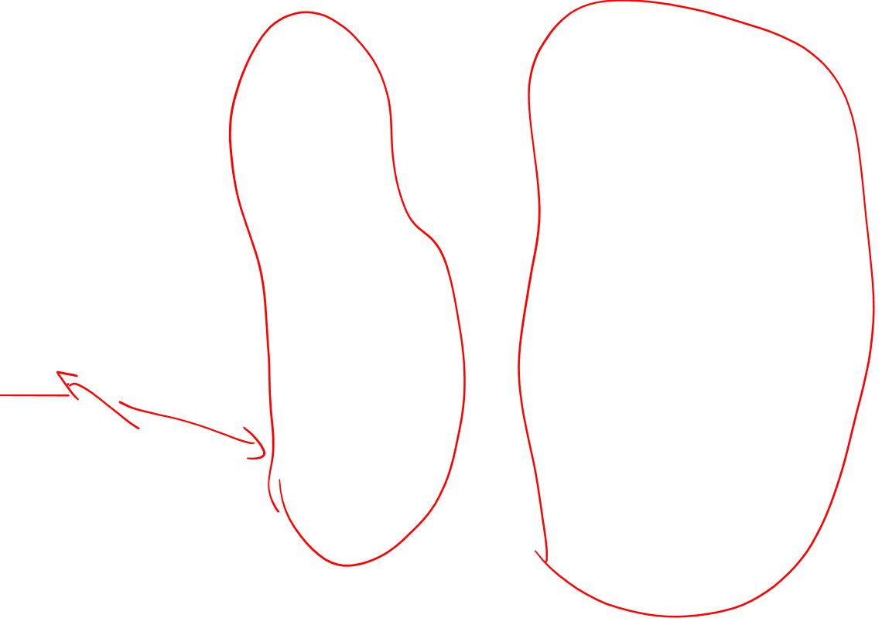
Superordinate Basic Subordinate
chair office chair
piano chair rocking chair
furniture lamp torchiere
desk lamp
table end table coffee table
Notes:
So if you look at the hierarchical category structure for, say, furniture.
At one end, have furniture, and at the other end, very specific types of furniture {read}.
In between, in the middle level – e.g. chair, table, lamp – are basic-level categories
The other levels can be named too:
Superordinate – the level above the basic-level category, contains basic level categories
Subordinate is the level below
But in what respects are these basic-level categories considered psychologically or cognitively basic? [next slide]

Slide 22
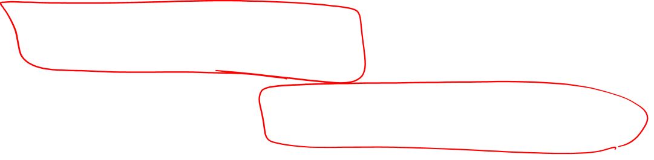
Connotation
Words have affective meanings
positive connotations (happy)
negative connotations (sad)
positive evaluation (great, love)
negative evaluation (terrible, hate).

Slide 23
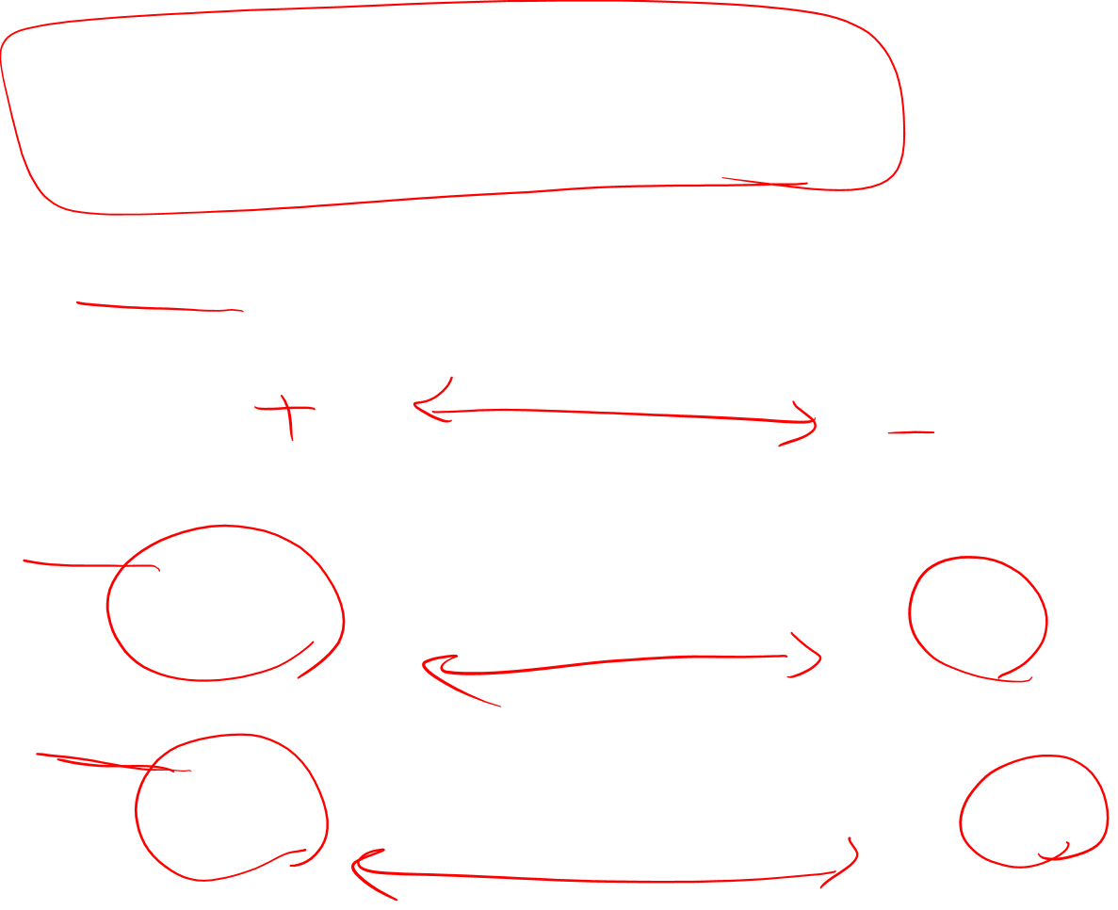
(Osgood et al., 1957)
happy or satisfied ………. Unhappy or annoyed
Excited or frenzied ………. Relaxed or calm
Important or controlling ………. awed or influenced

Slide 24
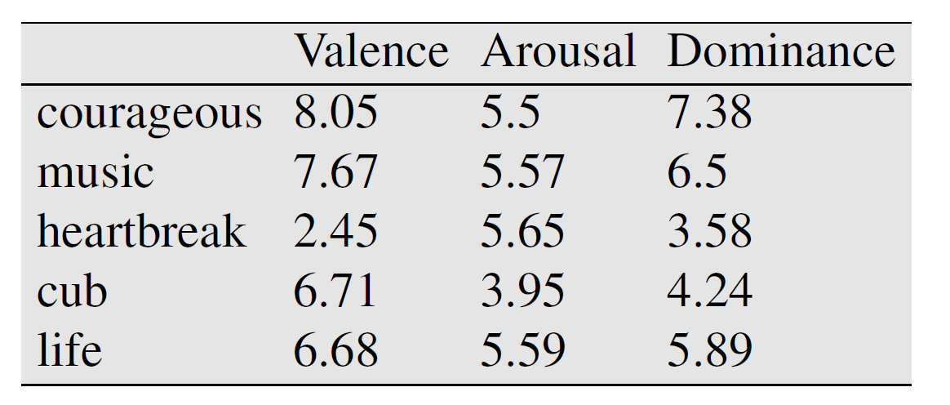
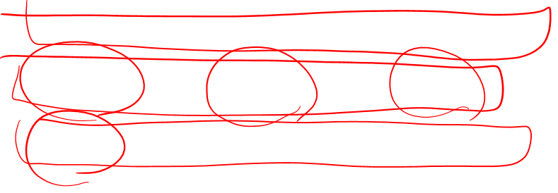

Slide 25
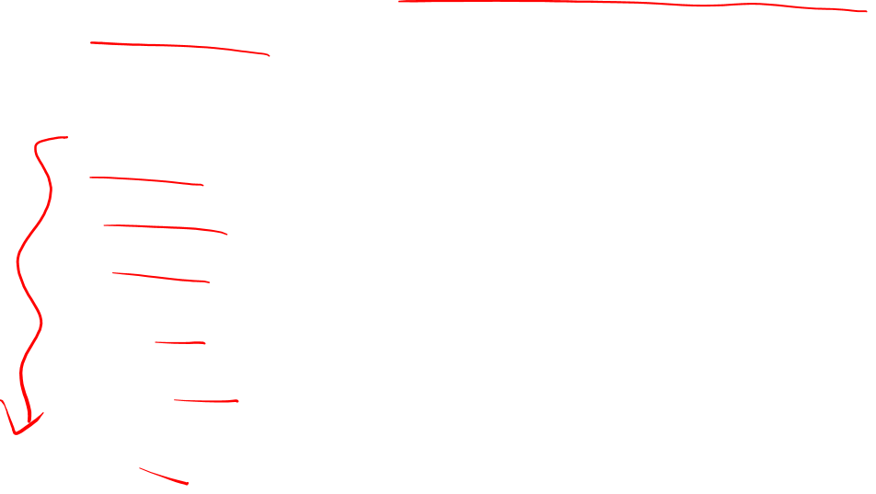
So far
Concepts or word senses
Have a complex many-to-many association with words (homonymy, multiple senses)
Have relations with each other
Synonymy
Antonymy
Similarity
Relatedness
Superordinate/subordinate
Connotation

Slide 26
But how to define a concept?

Slide 27
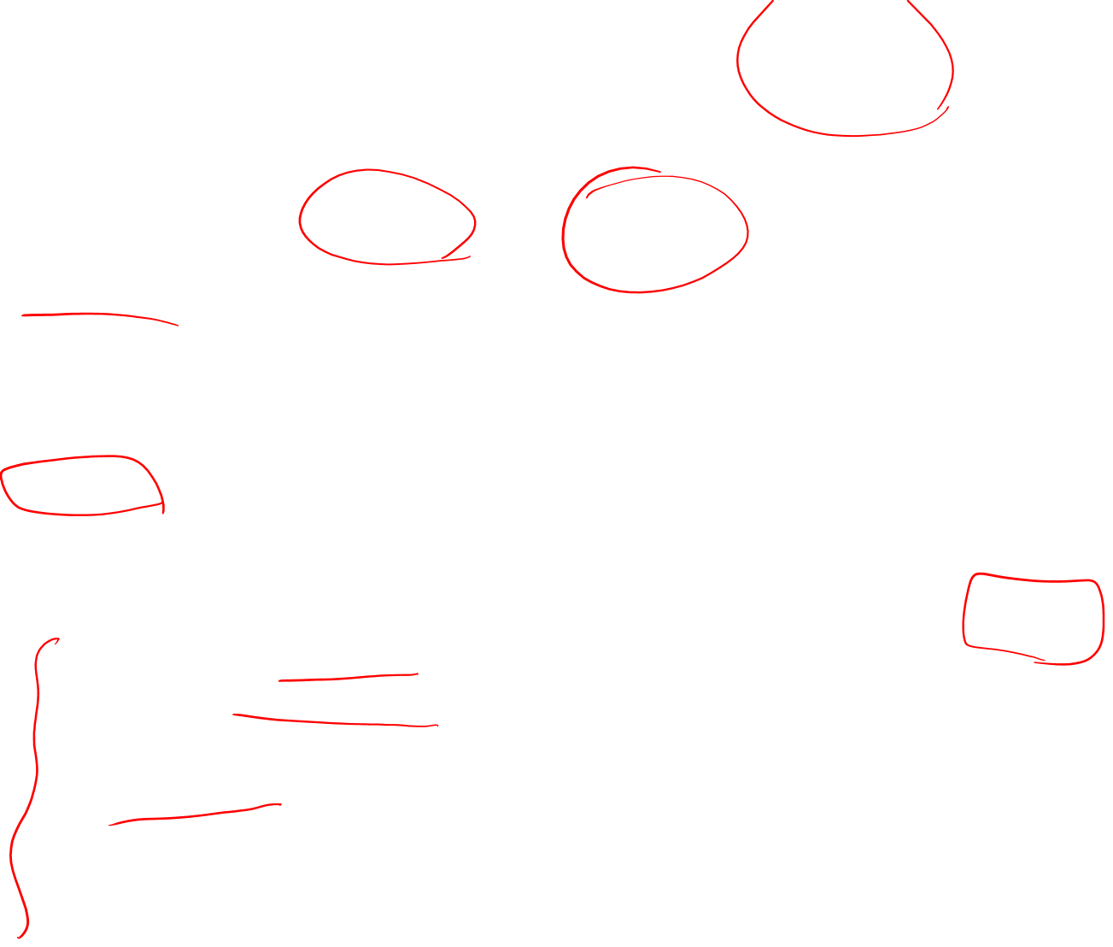
Classical (“Aristotelian”) Theory of Concepts
The meaning of a word:
a concept defined by necessary and sufficient conditions
A necessary condition for being an X is a condition C that X must satisfy in order for it to be an X.
If not C, then not X
”Having four sides” is necessary to be a square.
A sufficient condition for being an X is condition such that if something satisfies condition C, then it must be an X.
If and only if C, then X
The following necessary conditions, jointly, are sufficient to be a square
x has (exactly) four sides
each of x's sides is straight
x is a closed figure
x lies in a plane
each of x's sides is equal in length to each of the others
each of x's interior angles is equal to the others (right angles)
the sides of x are joined at their ends
Example from Norman Swartz, SFU

Slide 28
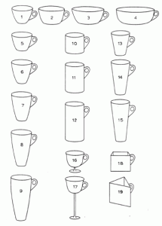
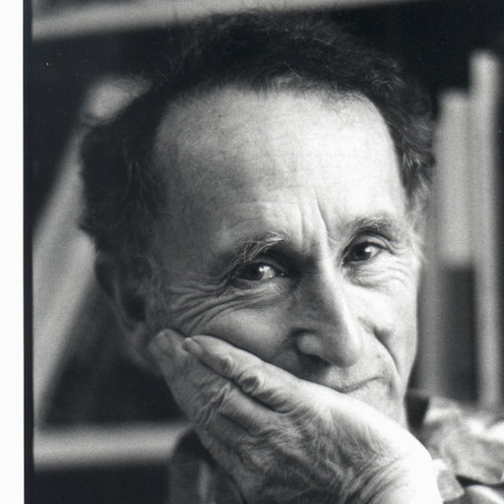
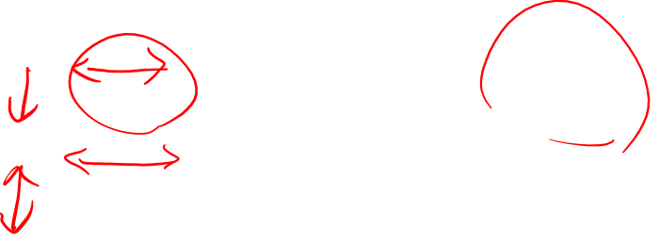
Problem 1: The features are complex and may be context-dependent
William Labov. 1975
What are these?
Cup or bowl?

Slide 29
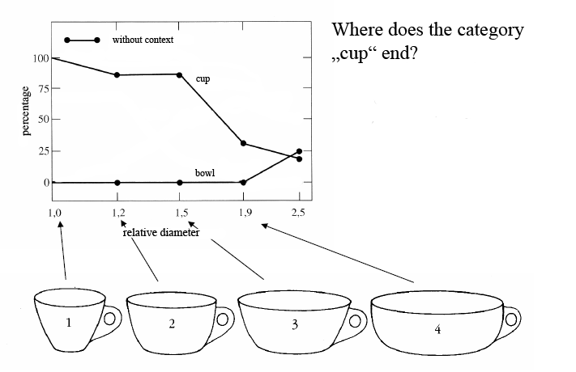
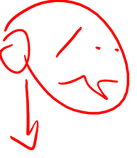
The category depends on complex features of the object (diameter, etc)

Slide 30
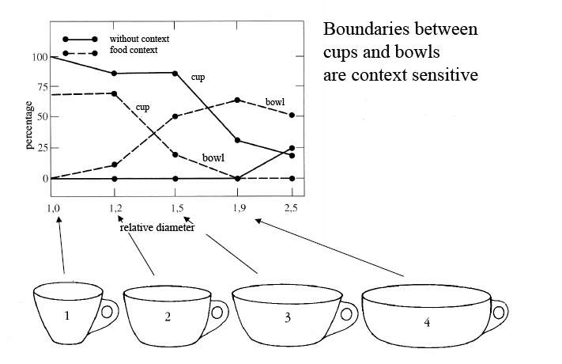
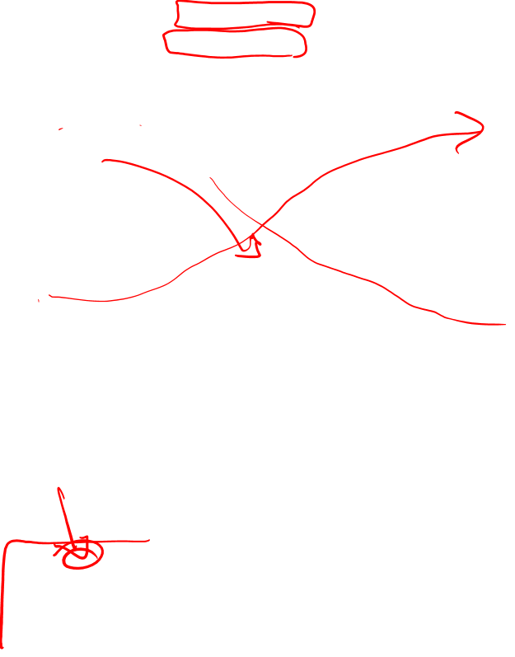
The category depends on the context! (If there is food in it, it’s a bowl)

Slide 31
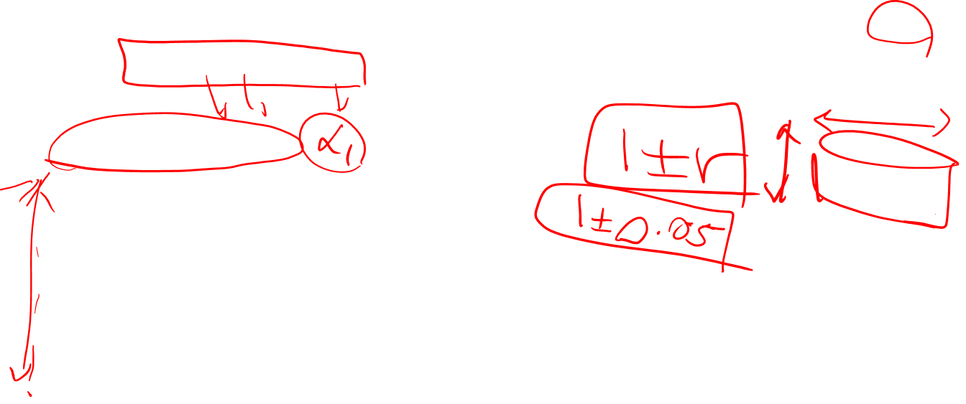
Labov’s definition of cup

Slide 32
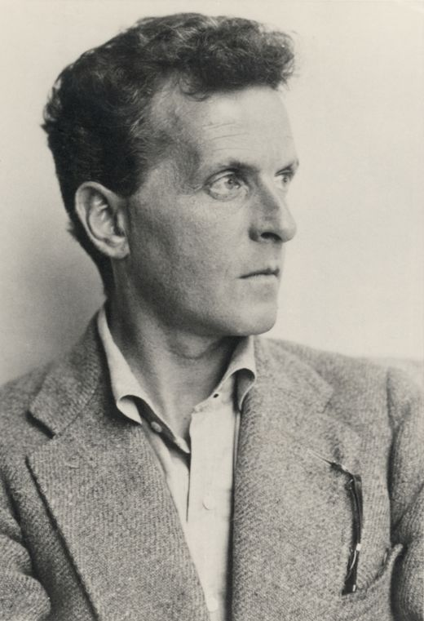
Ludwig Wittgenstein (1889-1951)
Philosopher of language
In his late years, a proponent of studying “ordinary language”

Slide 33
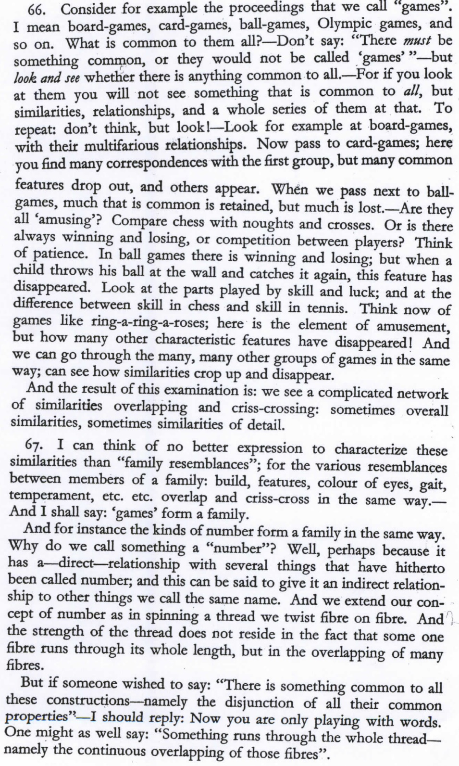
Wittgenstein (1945) Philosophical Investigations. Paragraphs 66,67

Slide 34
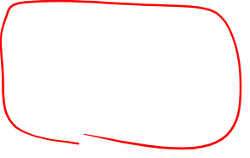
What is a game?

Slide 35
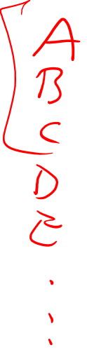
Wittgenstein’s thought experiment on "What is a game”:
PI #66:
”Don’t say “there must be something common, or they would not be called `games’”—but look and see whether there is anything common to all”
Is it amusing?
Is there competition?
Is there long-term strategy?
Is skill required?
Must luck play a role?
Are there cards?
Is there a ball?

Slide 36
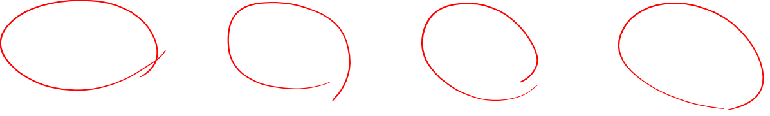
Family Resemblance
Game 1 | Game 2 | Game 3 | Game 4
ABC | BCD | ACD | ABD
“each item has at least one, and probably several, elements in common with one or more items, but no, or few, elements are common to all items” Rosch and Mervis

Slide 37
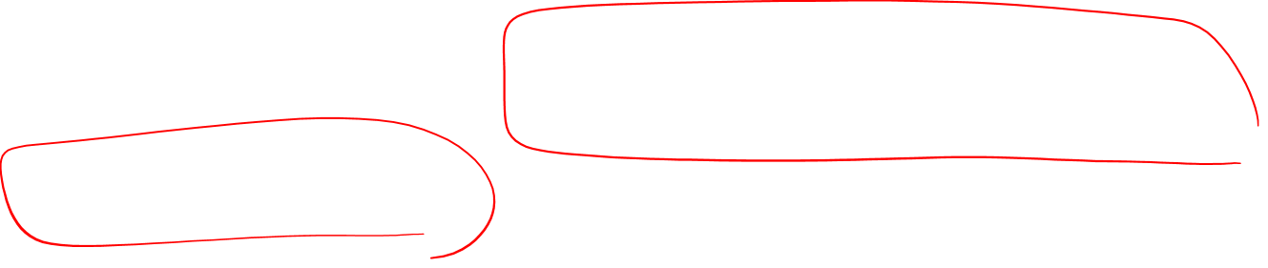
How about a radically different approach?

Slide 38
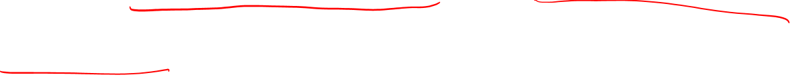
Ludwig Wittgenstein
PI #43:
"The meaning of a word is its use in the language"

Slide 39
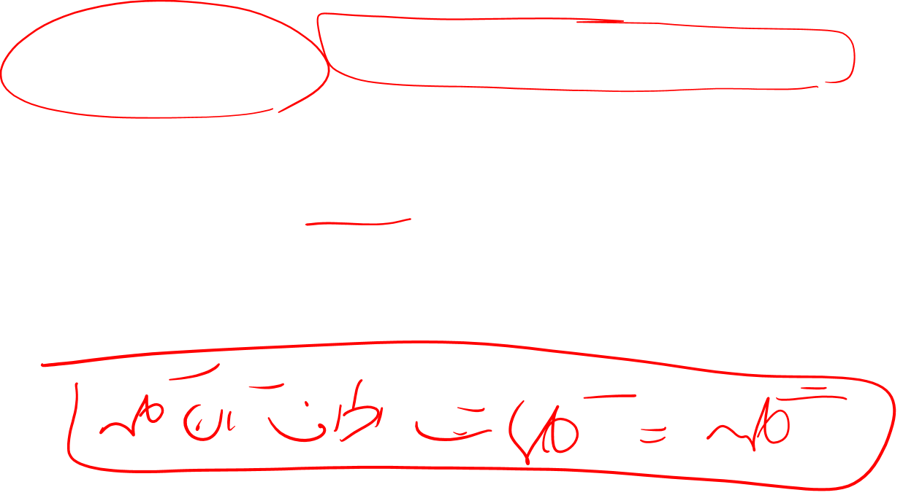
Let's define words by their usages
In particular, words are defined by their environments (the words around them)
Zellig Harris (1954): If A and B have almost identical environments we say that they are synonyms.

Slide 40
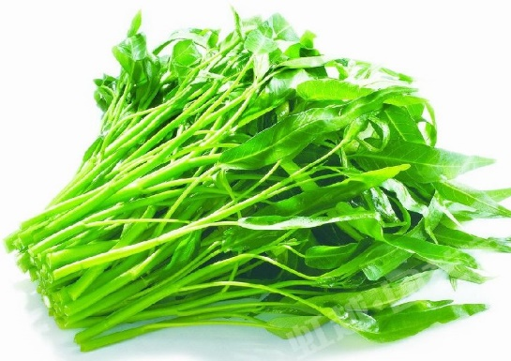
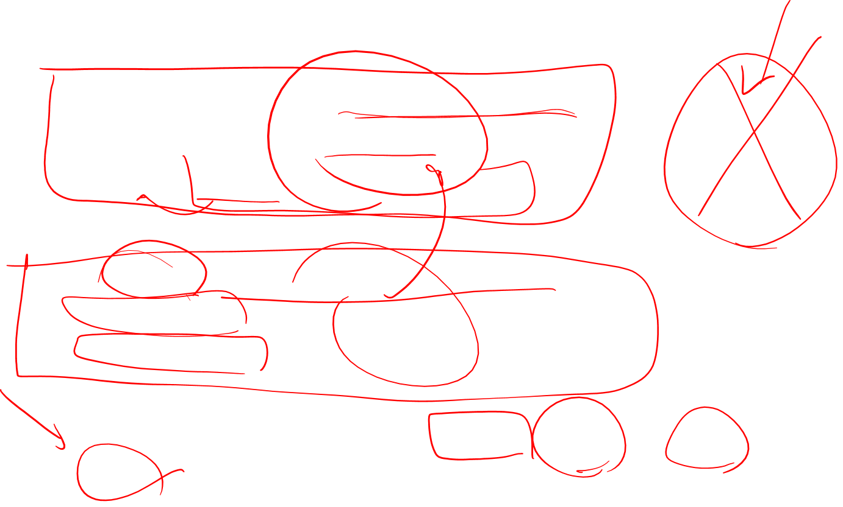
What does ongchoi mean?
Suppose you see these sentences:
Ong choi is delicious sautéed with garlic.
Ong choi is superb over rice
Ong choi leaves with salty sauces
And you've also seen these:
…spinach sautéed with garlic over rice
Chard stems and leaves are delicious
Collard greens and other salty leafy greens
Conclusion:
Ongchoi is a leafy green like spinach, chard, or collard greens

Slide 41
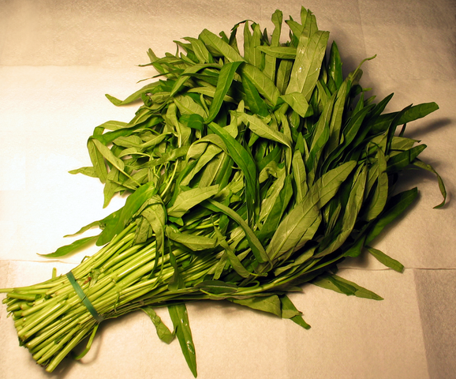
Ong choi: Ipomoea aquatica "Water Spinach"
Yamaguchi, Wikimedia Commons, public domain

Slide 42

We'll build a new model of meaning focusing on similarity
Each word = a vector
Not just "word" or word45.
Similar words are "nearby in space"

Slide 43

We define a word as a vector
Called an "embedding" because it's embedded into a space
The standard way to represent meaning in NLP
Fine-grained model of meaning for similarity
NLP tasks like sentiment analysis
With words, requires same word to be in training and test
With embeddings: ok if similar words occurred!!!
Question answering, conversational agents, etc

Slide 44

We'll introduce 2 kinds of embeddings
Tf-idf
A common baseline model
Sparse vectors
Words are represented by a simple function of the counts of nearby words
Word2vec
Dense vectors
Representation is created by training a classifier to distinguish nearby and far-away words

Slide 45
Review: words, vectors, and co-occurrence matrices

Slide 46

Term-document matrix
Each document is represented by a vector of words

Slide 47
Visualizing document vectors

Slide 48
Vectors are the basis of information retrieval
Vectors are similar for the two comedies
Different than the history
Comedies have more fools and wit and fewer battles.

Slide 49

Words can be vectors too
battle is "the kind of word that occurs in Julius Caesar and Henry V"
fool is "the kind of word that occurs in comedies, especially Twelfth Night"

Slide 50

More common: word-word matrix (or "term-context matrix")
Two words are similar in meaning if their context vectors are similar

Slide 51


Slide 52

Reminders from linear algebra
vector length

Slide 53

Cosine for computing similarity
Sec. 6.3
v_{i} is the count for word v in context i
w_{i} is the count for word w in context i.
Cos(v,w) is the cosine similarity of v and w
Notes:
See Law of Cosines (Cosine Rule) wikipedia page

Slide 54


Cosine as a similarity metric
-1: vectors point in opposite directions
+1: vectors point in same directions
0: vectors are orthogonal
Frequency is non-negative, so cosine range 0-1

Slide 55

 | large | data | computer
apricot | 1 | 0 | 0
digital | 0 | 1 | 2
information | 1 | 6 | 1
Which pair of words is more similar?
cosine(apricot,information) =
cosine(digital,information) =
cosine(apricot,digital) =

Slide 56
Visualizing cosines (well, angles)

Slide 57

But raw frequency is a bad representation
Frequency is clearly useful; if sugar appears a lot near apricot, that's useful information.
But overly frequent words like the, it, or they are not very informative about the context
Need a function that resolves this frequency paradox!

Slide 58

tf-idf: combine two factors
tf: term frequency. frequency count (usually log-transformed):
Idf: inverse document frequency: tf-
Total # of docs in collection
Words like "the" or "good" have very low idf
# of docs that have word i
tf-idf value for word t in document d:

Slide 59

Summary: tf-idf
Compare two words using tf-idf cosine to see if they are similar
Compare two documents
Take the centroid of vectors of all the words in the document
Centroid document vector is:

Slide 60

An alternative to tf-idf
Ask whether a context word is particularly informative about the target word.
Positive Pointwise Mutual Information (PPMI)

Slide 61


Pointwise Mutual Information
Pointwise mutual information:
Do events x and y co-occur more than if they were independent?
PMI between two words: (Church & Hanks 1989)
Do words x and y co-occur more than if they were independent?
$$\text{PMI}\left({word}_{1}, {word}_{2}\right)={\text{log}}_{2}\frac{P({word}_{1}, {word}_{2})}{P\left({word}_{1}\right)P({word}_{2})}$$

Slide 62


Positive Pointwise Mutual Information
PMI ranges from $−∞ \text{to} +∞$
But the negative values are problematic
Things are co-occurring less than we expect by chance
Unreliable without enormous corpora
Imagine w1 and w2 whose probability is each 10⁻⁶
Hard to be sure p(w1,w2) is significantly different than 10⁻¹²
Plus it’s not clear people are good at “unrelatedness”
So we just replace negative PMI values by 0
Positive PMI (PPMI) between word1 and word2:
$$\text{PPMI}\left({word}_{1}, {word}_{2}\right)=\max\left({\text{log}}_{2}\frac{P({word}_{1}, {word}_{2})}{P\left({word}_{1}\right)P({word}_{2})},0\right)$$

Slide 63
Computing PPMI on a term-context matrix
Matrix F with W rows (words) and C columns (contexts)
f_{ij} is # of times w_{i} occurs in context c_{j}

Slide 64


p(w=information,c=data) =
p(w=information) =
p(c=data) =
6/19
= .32
11/19
= .58
7/19
= .37

Slide 65
pmi(information,data) = log₂ (
.32 /
(.37*.58) )
= .58
(.57 using full precision)

Slide 66

Weighting PMI
PMI is biased toward infrequent events
Very rare words have very high PMI values
Two solutions:
Give rare words slightly higher probabilities
Use add-one smoothing (which has a similar effect)

Slide 67

Weighting PMI: Giving rare context words slightly higher probability
Raise the context probabilities to $α=0.75$:
This helps because $P_{α}\left(c\right)>P\left(c\right)$ for rare c
Consider two events, P(a) = .99 and P(b)=.01
$P_{α}\left(a\right)=\frac{{.99}^{.75}}{{.99}^{.75}+{.01}^{.75}}=.97$ $P_{α}\left(b\right)=\frac{{.01}^{.75}}{{.01}^{.75}+{.01}^{.75}}=.03$

Slide 68
Use Laplace (add-1) smoothing

Slide 69


Slide 70

PPMI versus add-2 smoothed PPMI

Slide 71

Summary for Part I
Survey of Lexical Semantics
Idea of Embeddings: Represent a word as a function of its distribution with other words
Tf-idf
Cosines
PPMI
Next lecture: dense embeddings, word2vec

